Slide 1
Novel View Synthesis and 3D Representation Learning with ODE Deformation Networks for 3D Gaussians
Daniel Wang

Slide 2
About myself…
Daniel Wang, 1st year PhD student from Yale University
Currently in Yale Vision lab at the Computer Science department
Research focus:
Computer vision and machine learning
3D Vision
Computational neuroscience

Slide 3
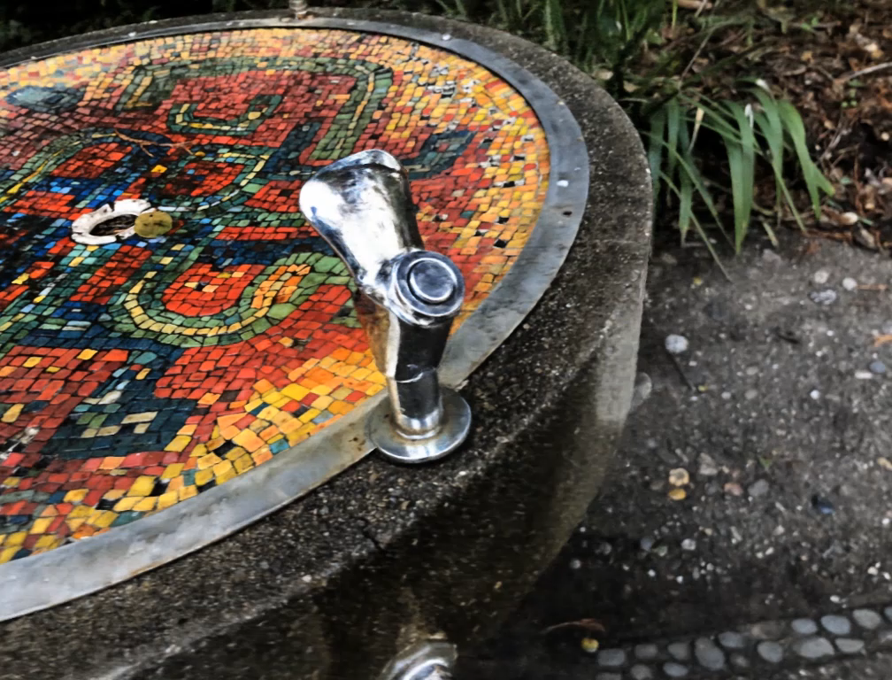
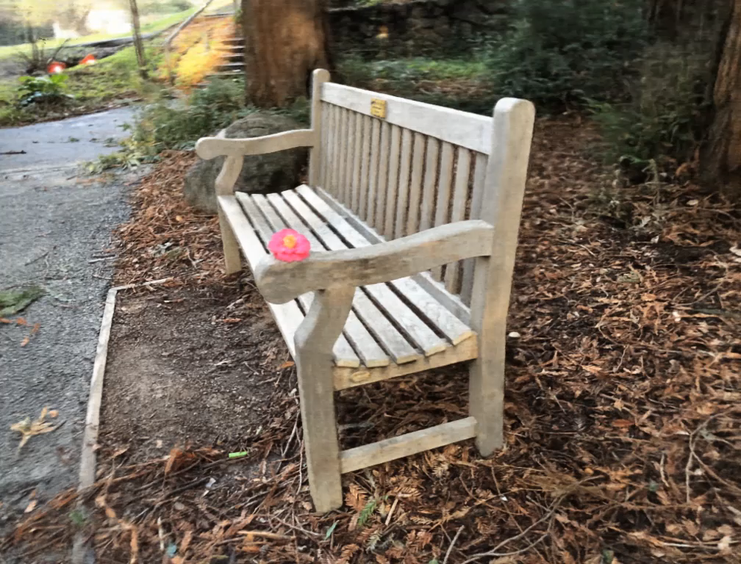
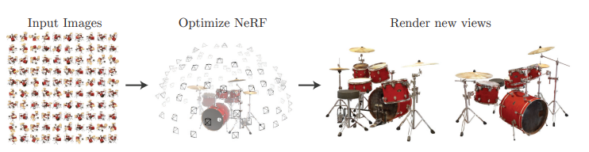
Radiance fields, representation learning, and novel view synthesis
Radiance fields models aims to learn a set of parameters that can represent the appearance of an underlying 3D scene, by learning to synthesize novel views and comparing it to ground truth images.
Requires only images to train, does not need extra labeling

Slide 4
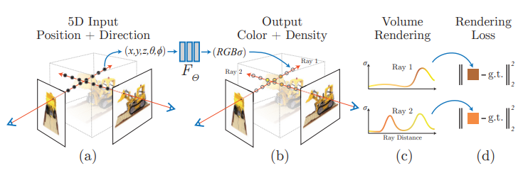
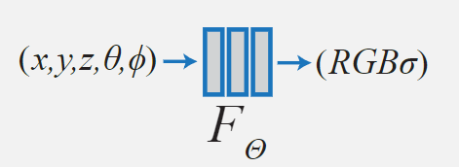
NeRF: Neural Radiance Fields
NeRF uses a fully connected neural network to approximate the color/radiance and the volume density, given a viewing direction and spatial coordinates
Differentiable volume rendering is then used to synthesize images and used for loss computation

Slide 5
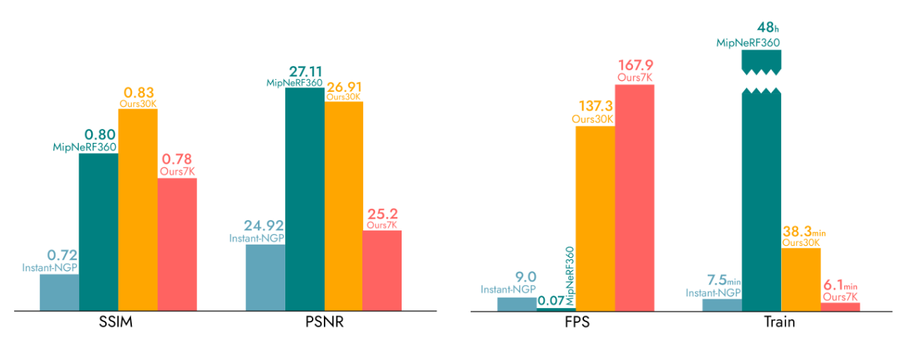
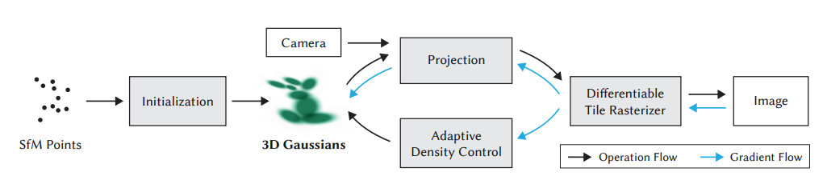
3D Gaussian Splatting
Instead of using a deep neural net to model appearance, a set of 3D Gaussians were used, parameterized by mean, covariance, opacity, and spherical harmonic coefficients.
Color for each 2D Pixel accumulates color from each intersecting Gaussian on the ray

Slide 6
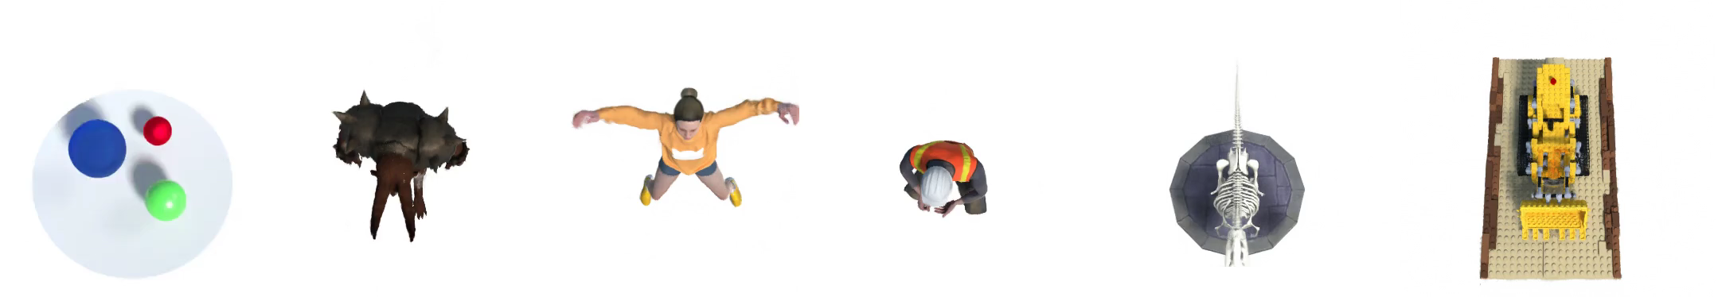
Dynamic 3D scenes
Vanilla novel view synthesis tasks rely on the assumption that scenes are stationary : objects within the scene does not move
If we get rid of this assumption, then we introduce one extra degree of freedom in time (3D -> 4D)
How can we still model scene 3D structure without needing too much additional data?

Slide 7
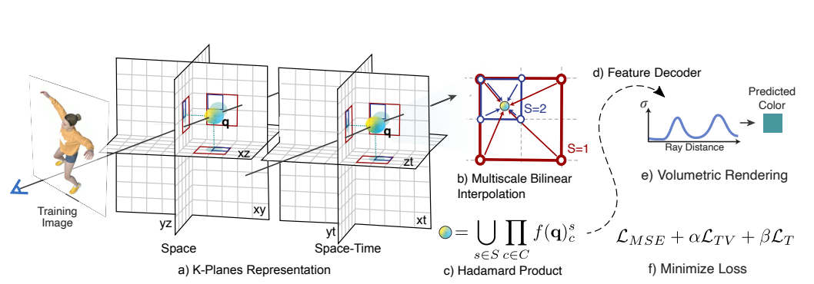
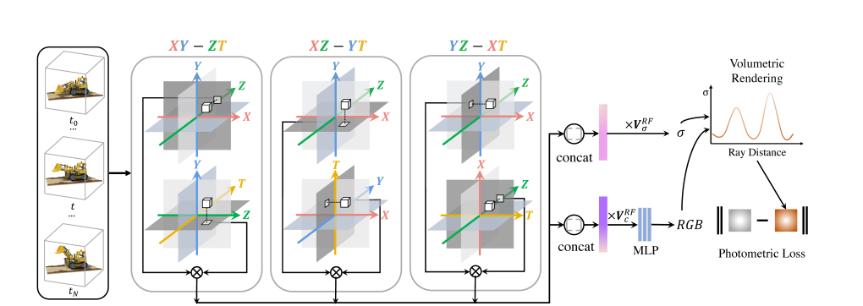
K-Planes and HexPlane: Factorized storage of 4D features (NeRF based)
To address the addition of the time factor, some works have focused on learning intermediate representations, which store 4D features more explicitly, by querying features in the 6 planes and aggregating features before they are used to compute color and opacity

Slide 8
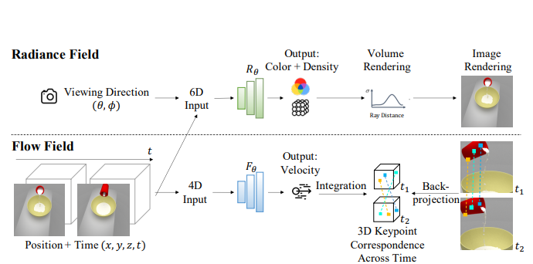
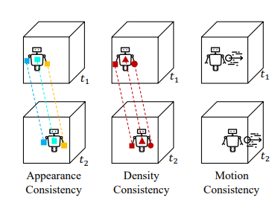
NeRFlow: Flow-enforced regularizations (NeRF based)
Increases input size of the network to incorporate time as an extra factor.
Assumes certain aspects of the scene that is invariant, mainly the appearance features of points that correspond to the same object should be similar
Uses a flow field to estimate gradient of object motion, supervised by optical flow

Slide 9
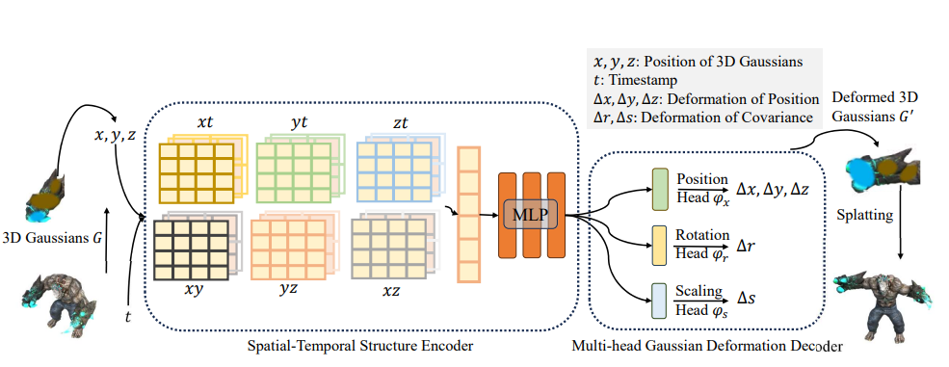
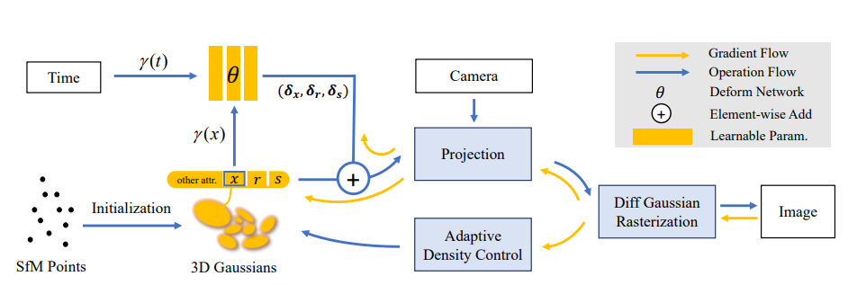
4D Gaussians & Deformable 3D Gaussians: Gaussian Splatting with a deformation network
Adding in time as an input factor to the 3D Gaussians representation itself would massively increase the number of needed parameters, and make it hard for the model to learn from multiple frames
The more widely adopted method is to have a separate deformation network that transforms the gaussians from a canonical set to each frame.
For 4D gaussians, the planes representation from hexplanes is also used as an intermediate layer.

Slide 10
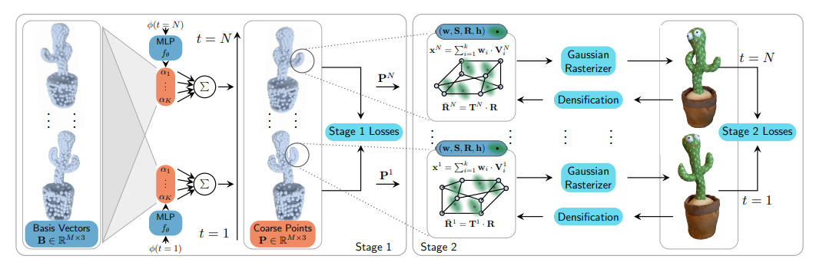
Neural Parametric Gaussians : point deformation guidance
Deformation can also be applied on point-level, which is then used to guide the locations of Gaussians

Slide 11
Why do we need to treat time in such special manners?
No method have been successful in modeling Dynamic 3D scenes with a simple addition of extra time dimension
Frame to frame data have many shared features, and the underlying 3D scene usually moves continuously and slowly with time, due to underlying physical constraints.
3D dynamic Gaussians can be trained faster than NeRF at competitive performance, but the design of the deformation network is always kept as a simple MLP
Can we bake in regularizations into our model design itself?

Slide 12
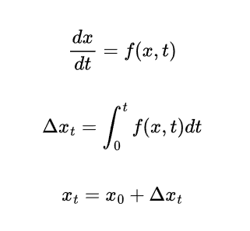
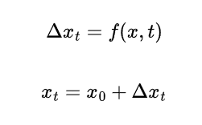
Modeling deformation networks as an ODE function
Representing the deformation network makes the assumption that the underlying function that models the deformation is a smooth and continuous function, which dynamics can be represented by integration of its gradients with respect to t.
There are two regularizations involved:
Neighboring frames close together in time have to share similar set of parameters
The underlying dynamic can be calculated from any position, while later parameters will always depend on earlier parameters
V.S.

